Slide 1
Securing E-Commerce: Methods and Models in E-Transactions
Derrick Murphy
Information Security

Slide 2
Abstract
Security in relation to eCommerce was focused on in this paper
E-Commerce is defined as commercial transactions conducted electronically on the internet.
This internet is rapidly expanding along with the development of the eCommerce and associated electronic devices
The area is still increasingly popularity as a commerce medium
Resulting from the research my paper covered six different topics in eCommerce
E-Commerce Infrastructure, Digital Cash, Transborder Data flow, Government Technology Policy, Security Services, and Software and Application Security.

Slide 3
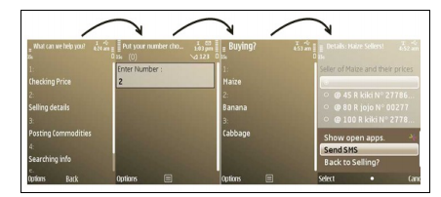
Empowerment of rural farmers through information sharing using inexpensive technologies
A comprehensive mobile and phone application was designed for rural farmers of East Cape, Africa. Polls were administered to the local farmers to guide the development of the system. As a result the farmers reported increases in sales and were pleased with the new technology.
Iraba, M. Louise, and I. M. Venter. “Empowerment of rural farmers through information sharing using inexpensive technologies.” Proceedings of the South African Institute of Computer Scientists and Information Technologists Conference on Knowledge, Innovation and Leadership in a Diverse, Multidisciplinary Environment - SAICSIT 11, 2011, doi:10.1145/2072221.2072257.

Slide 4
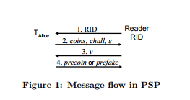
PSP: Private and Secure Payment with RFID
A RFID protocol was developed to accept payment. The system uses encryption along with security and privacy requirements to protect the information. As a result a well-established RFID payment method has been created to accept payments.
Blass, Erik-Oliver, et al. “PSP: Private and Secure Payment with RFID.” Computer Communications, Elsevier, 10 Nov. 2012, www.sciencedirect.com/science/article/pii/S0140366412003830.
Notes:
Reader RID initiates the protocol TAlice Reader RID 1. RID! 2. coins, chall, ! 3. v 4. precoin or prefake Figure 1: Message flow in PSP by sending RID to tag TAlice. TAlice responds by sending two coins, a valid coin and a fake one. Sending these coins serves both the purpose of confusing a potential adversary and achieving TAlice’s commitment for the payment. TAlice also sends a challenge chall and the epoch of the valid coin. Upon receipt of message 2 and successful verification of the valid coin, the reader replies by sending verification bits v. Finally, if v matches chall, the reader is authenticated and TAlice reveals the preimage of the committed valid coin, otherwise the authentication of the reader has failed, and TAlice replies with the preimage of the committed fake coin.

Slide 5
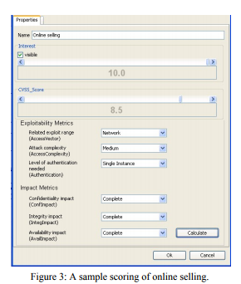
A Multi-Layer Tree Model for Enterprise Vulnerability Management
A calculator that scores the vulnerability of a eCommerce business to understand its strength was designed. A base metric is used to describe the topology vulnerability. This design enables a enterprise understand the overall security of their network.
WU, Bin, and Andy JU An Wang. “A Multi-Layer Tree Model for Enterprise Vulnerability Management.” ACM Digital Library, ACM, dl.acm.org/citation.cfm?doid=2047594.2047661

Slide 6
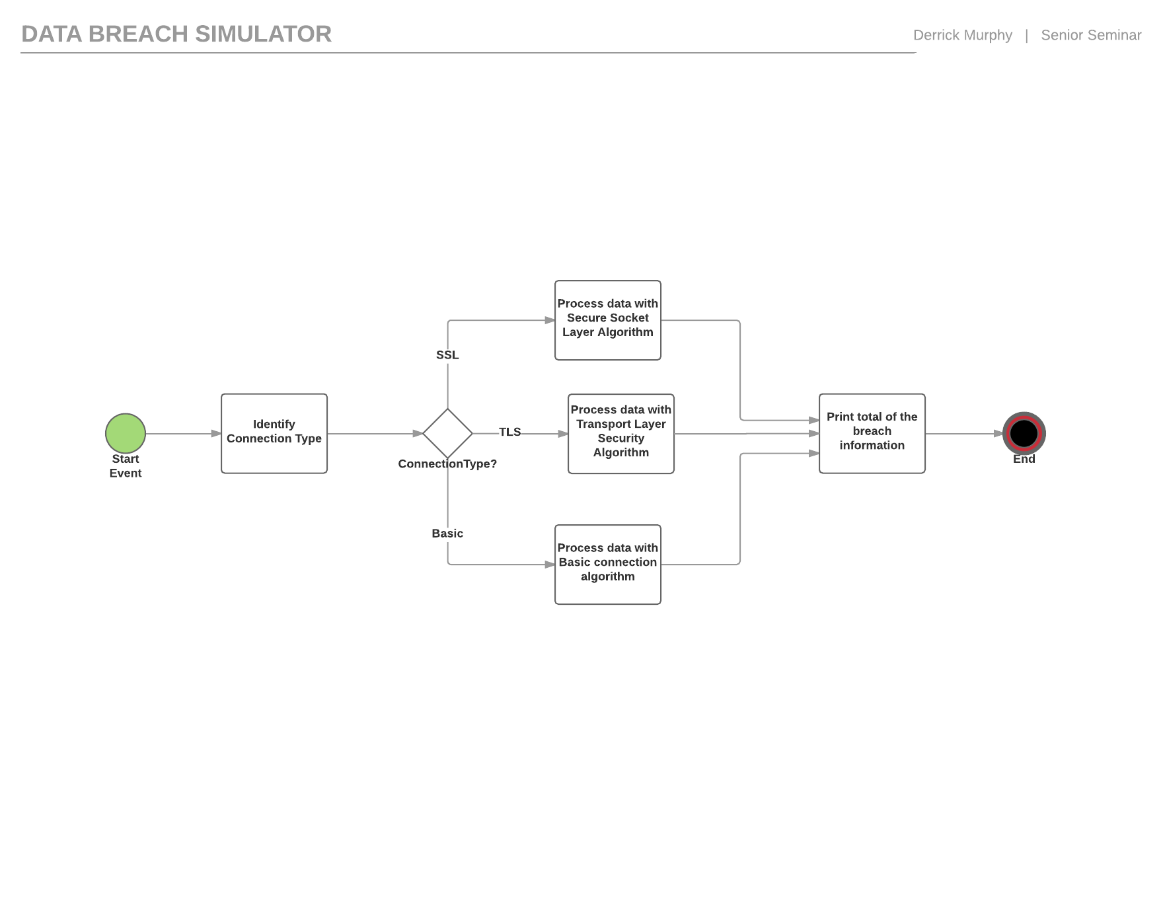
Research Design
The motivation of this research was to help those unfamiliar to methods of securing transferred data in e-commerce understand their risk.

Slide 7
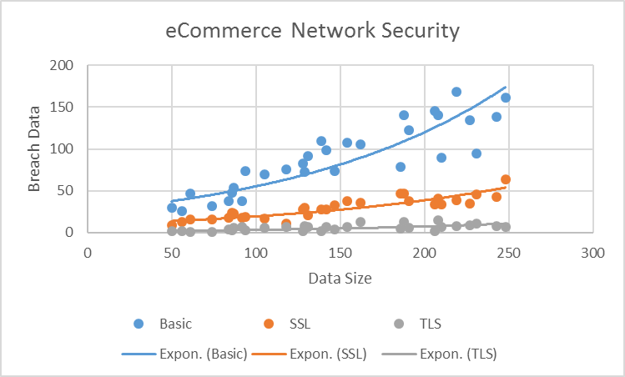
Descriptive Statistics

Slide 8
Null Hypothesis & Sample Data
There is no significant difference in the size of the data breached between using a SSL,TLS or a basic connection.
Mean |  | 89.50556 | 29.55052 | 5.956146
StDev |  | 41.07646 | 12.85432 | 3.618271
variance |  | 1687.275 | 165.2335 | 13.09189
N |  | 30 | 30 | 30
T-Value(Basic and SSL) |  | 0.193699
P-Value(Basic and SSL) |  | 6.43E-09
P-Value(TLS and SSL) |  | 3.06E-11
P-Value is lower than 0.05
Probability the observed results are random are due to chance are low
Conculsion : Null hypothesis is denied

Slide 9
Future Research:
eCommerce Policy
Information is shared throughout the world using eCommerce and there are limited authority on this information currently
Government use of eCommerce vary among government organizations
Career Plans:
I plan on working a career related to Computer Science
I would like to get certifications in Security + and Network+

